Slide 1
Safeguarding those who self-neglect and hoard under the Care Act 2014

Slide 2
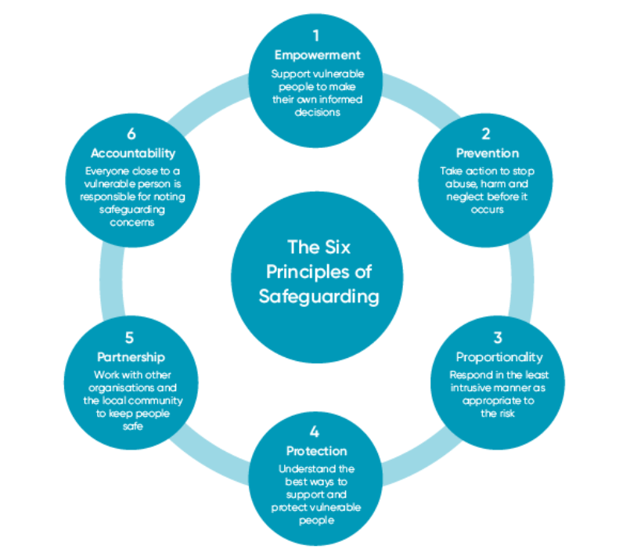
Safeguarding principles
The six statutory safeguarding principles underpin all aspects of adult safeguarding work. These should be clearly and openly addressed from the outset and placed at the heart of decision-making and action.
Application of the six statutory safeguarding principles supports practice capable of achieving a wide range of responses tailored to meet the needs of the individual. Alongside this there must be transparency in applying the Mental Capacity Act, Human Rights Act and Date Protection Act - GDPR.

Slide 3
A safeguarding concern is:
Where there is reasonable cause to suspect that an adult who has or may have needs for care and support and is at risk of or experiencing of abuse or neglect. Care Act 2014 Section 42 (1) (a) and (b).
This definition directs us to all work together to improve our understanding of the risks and experiences of adults who have needs for care and support:
• it will improve our ability to prevent or intervene early when there are concerns of abuse or neglect
• it will enhance joint working to prevent, reduce or delay the risk of harm to the adult
• it will ensure that safeguarding concerns are identified and reported to support the adult
• it will ensure that those who have a statutory duty to enquire, act in a timely, person centered and coordinated way.
Notes:
The well-being and safety of local people is our main concern, and we adopt a zero tolerance stance on the abuse, neglect or discrimination of any person but particularly people at risk or in vulnerable situations in whatever setting. There is good partnership working at the local level when concerns are raised and services work together effectively to ensure a co-ordinated approach. If you are concerned that you or another adult is being neglected, harmed, or abused in any way, please do not ignore it. Any suspicion of abuse or neglect should be reported.

Slide 4
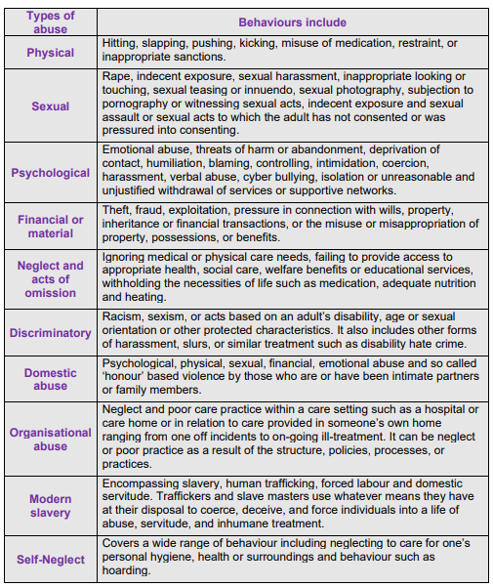
Types of abuse
Notes:
What is meant by ‘abuse and neglect’? Abuse and neglect can happen to anyone, whatever their circumstances and can be carried out by anyone. This could be family, friends, neighbours, paid staff, carers, or volunteers. It could also be strangers. This table reflects some examples of the types and categories of abuse and neglect and examples of indicators.

Slide 5
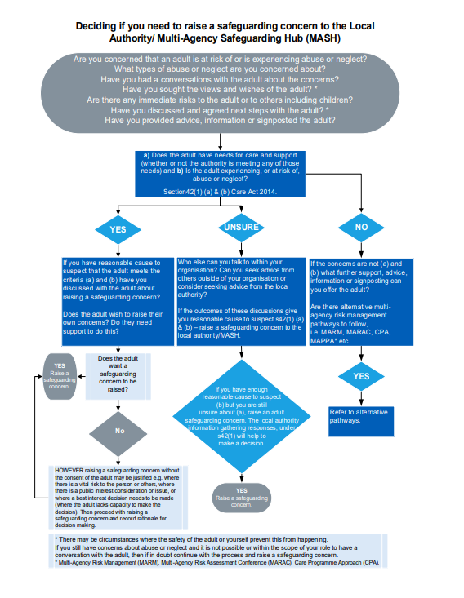
Deciding if you need to raise a safeguarding concern
4LSAB Safeguarding Concerns (hampshiresab.org.uk)
Notes:
The flowchart below reflects the decision making for a safeguarding concern. There is advice within the Safeguarding concerns guidance that should help to inform this decision making

Slide 6
Identifying and recognising Risk
Where a person with needs of care and/or support is refusing support and in so doing is placing themselves or others at risk of serious harm, advice and information should be shared with the adult about the risk(s) of involvement or noninvolvement. Professional judgement will determine whether or not the level of risk has reached an unmanageable level for your organisation.
All professionals have a vital role to play to make early, positive interventions with individuals and families so as to make a difference to their lives, preventing the deterioration of a situation or breakdown of a vital support network.
Where professionals perceive the risk to be too high to work in the environment due to hoarding it is vitally important to not make this decision in isolation. This will need to be communicated with both managers and LA. Your own organisation will determine what level of risk is manageable.
If the person refuses support this is a complex decision-making process, again not to be made in isolation. It is likely to need LA support in relation to whether the person is putting themselves or others lives at risk.
Things you may need to consider when managing these risks:

Slide 7
Human Rights Act 1998
Safeguarding Section 42 Care Act 2014
Care Act 2014 Care needs assessment section 9
Care Act 2014 Carers Assessment Section 10
Environmental health
Advocacy – Care Act / IMCA / IMHA
Mental Capacity Act 2005
Own Policies and Procedures
Equality Act 2010
Tenancy and housing law
Domestic Abuse
Mental Health Act 1983
Notes:
Alison

Slide 8
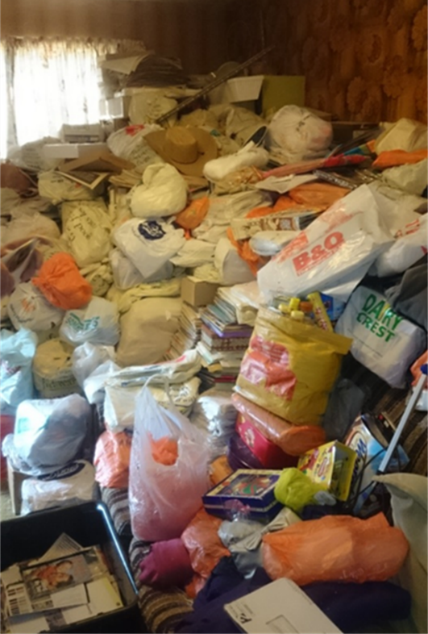
What is hoarding/Self Neglect?
‘Hoarding is the excessive collection and retention of any material to the point that living space is not able to be used for its intended purpose.’
Hoarding disorder is a persistent difficulty in discarding or parting with possessions.
Hoarding is considered a standalone mental health disorder and is included in the 5th edition of the Diagnostic and Statistical Manual of Mental Disorders (DSM) 2013. However, hoarding can also be a symptom of other medical disorders; it is not a lifestyle choice.
Self Neglect can be displayed in Hoarding type behaviours, but it can also look very different.
The Care Act 2014 Statutory Guidance defines that self-neglect is a “wide range of behaviours” including “neglecting to care for one’s personal hygiene, health or surroundings” and can include certain behaviours such as “hoarding”. Often this is a situation in which someone demonstrates a “lack of care for themselves and or their environment and refuses assistance or services”.

Slide 9




Recognising Self-neglect
The Care Act 2014 Statutory Guidance defines that self-neglect is a “wide range of behaviours” including “neglecting to care for one’s personal hygiene, health or surroundings” and can include certain behaviours such as “hoarding”. Often this is a situation in which someone demonstrates a “lack of care for themselves and or their environment and refuses assistance or services”.
Reasons for self-neglect
Self-neglect can be a result of a diverse range of issues and challenges faced by individuals, so it is important to look at the neglect or hoarding in the context of the individual’s life.
Often the reasons for the self-neglect have stemmed from problems such as health difficulties, injury, trauma, homelessness, loss or social isolation.
The Care Act Statutory Guidance 2023 recognises it can be difficult to distinguish between whether a person is making a capacitated choice to live in a particular way (which may be described as an unwise choice or decision) or whether: The person lacks mental capacity to make the decision; or there is concern regarding the adult’s ability to protect themselves by controlling their own behaviour.
Consider if the person has the functional capacity to make a particular decision and executive capacity which is the ability to carry out the decision.
Types of Self-neglect
Lack of self-care to an extent that it threatens personal health and safety
Neglecting to care for one’s personal hygiene, nutrition, health or surroundings, leading to increased risk of fire due to hoarding.
Failure to seek help or access services including non-attendance at appointments
Indicators of Self-neglect
Very poor personal hygiene,
Unkempt appearance, lack of appropriate clothing
Malnutrition/dehydration, lack of essential food
Living in hoarding, squalid or unsanitary living conditions, neglecting household maintenance
Collecting a large number of animals in inappropriate conditions
Non-compliance with health or care services, inability or unwillingness to take medication or treat illness or injury
Things to consider be professionally curious
What is the adults view of the neglect, do they recognise it, see it as a risk?
Is this a long-established behaviour or a recent decline as a response to a change in life, trauma, relationship breakdown, coping mechanism, etc.
What strengths does the person have – what are they managing well and how can this be built on? What motivation for change does the person have? ​
Are there links between the self-neglect and health, disability, substance use or the person’s life history, family or social relations? ​
Self neglect behaviours maybe hidden for years and therefore agencies may only become aware when risks have increased.

Slide 10
Multi-Agency Roles and Responsibilities
Successful intervention is more likely when different services work together to identify solutions and look at a person’s needs/risks as a whole. While things like cleaning interventions may provide a short-term solution to self-neglect and/or hoarding, longer-term solutions should be sought as part of an integrated multi-agency plan.
The aim is to prevent serious injury or death of the individuals by ensuring that:
  The person is empowered as far as possible to make their own decisions and to make changes to their circumstances that lead to positive outcomes
  There is a shared, multi-agency understanding and recognition of issues
  There is effective and practical multi-agency working, which challenges practice and ensures that concerns/risks receive appropriate prioritisation
  There is a proportionate response to the level of risk to self and others
Language and Engagement
Language (both that which is written and spoken) used by professionals about individuals who self neglect should be respectful of the person, not judgemental, and should also follow Making Safeguarding Personal principles.
Using positive, respectful language can build trust and lead to better outcomes for the individual, as they are more likely to engage with any suggested changes, services or interventions.
Individuals who self-neglect often decline support and may not identify that they need support. Due to the nature of self-neglect, be mindful that engagement may take time and fluctuate.
Raising a Safeguarding Concern
Make a Safeguarding Referral to Local Authority detailing concerns – click links below to take you to safeguarding adult contact information for the individual 4LSAB areas:
Southampton Portsmouth
Isle of Wight Hampshire
Useful Links
4LSAB Multi-Agency Guidance on Responding to Self-Neglect and Persistent Welfare Concerns
Multi-agency Hoarding Guidance 2022
4LSAB Multi-Agency Safeguarding Adults Escalation Protocol
4LSAB 7-Minute Guide to Professional Curiosity
4LSAB Multi-Agency Risk Management Framework

Slide 11
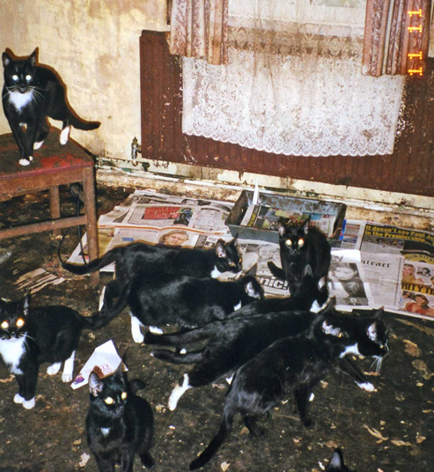
The 3 main types of hoarding
Compulsive / Generalist hoarding: Clinical compulsive hoarding - This is the most common. This could consist of one type of object or collection of a mixture of objects, such as old clothes, newspapers, food, human waste. This will often manifest from an emotional attachment creating conflict in disposal.
Bibliomania: Books and written information – such as newspapers, magazines, DVDs and videos, and Data Hoarding. It could present with the storage of equipment such as computers, electronic storage devices or paper. A need to store copies of emails, and other information.
Animal hoarding: Often accompanied with the inability to provide minimal standards of care. The hoarder is unable to recognise that the animals are at risk because they feel they are saving them. The homes of animal hoarders are often destroyed by the accumulation of animal faeces and infestation by pests.

Slide 12
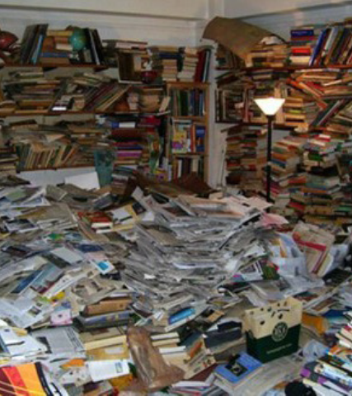
General Characteristics of Hoarding
Reasons for saving items may include:
  Instrumental saving pattern – ‘What if I or someone else needs it’
  Sentimental saving – ‘It means so much’
  Aesthetic saving – ‘I love it’
  Fear and Anxiety
  Long term behaviour pattern
  Excessive attachment to possessions
  Indecisiveness
  Socially Isolated
  Churning behaviour – going over things again and again but not throwing away
A person who hoards may see nothing wrong with their behaviour and have little insight on the impact it has on them and others.

Slide 13
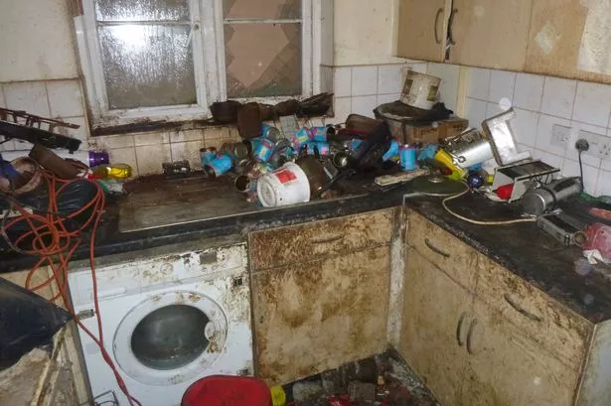
Hoarding, Self-neglect, Squalor or collecting
All circumstances have things in common and importantly may cause the adult to be nervous to disclose.
Hoarding/ Self Neglect - Those who are displaying hoarding/self-neglecting behaviour will likely be reluctant to allow any changes to their home, removing items or cleaning.
Squalor – Those whose property has descended into squalor may be more relieved to have someone offer to help them sort the situation out.
Collecting – Collecting needs to be considered in relation to what is being collected, is it causing a risk, breach of tenancy, is it well managed and not impacting on the use of the home.

Slide 14
Contributing factors ‘the meaning in the mess’
Upbringing
Deprivation, never having enough
Life events – bereavement, loss
Collector
Unable to clear the items – disability or long-term illness
Chronic disorganisation – brain injury, neurodiverse conditions
Socially isolated

Slide 15
Do’s and Don’t’s
Visiting unannounced may not always work
Don’t touch the persons items without their permission
Never remove possessions without this being agreed in writing
Don’t expect a quick change, this will take time, these cases are complex
Don’t try and catch them out
Don’t make negative comments about their items
Ensure you stay clear about your aims
Making decisions in isolation is a risk, keep talking to your colleagues
Balance enforcement with support
Make key referrals
Be clear about your expectations
Focus on escape routes first
Do set clear times when you will visit, consistency is key
Do think creatively about how to meet and build a report with the adult.
Always work with the person, empower them in the process, set actions jointly
Keep the process moving, even if there’s resistance
Start with small steps, could be as much as a square foot, they need to be reasonable and achievable
Celebrate successes however small

Slide 16
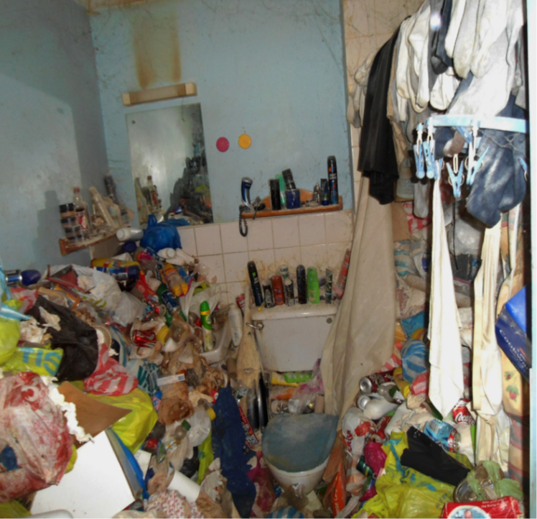
When Hoarding/Self-Neglect becomes a safeguarding concern
Hoarding and self-neglect can affect more than the individual it can affect the whole family and it’s vitally important the whole family is considered in these circumstances.
The person must have care and support needs – if they don’t this does not mean nothing further can be done.
When considering if someone has an inability to protect themselves in the context of hoarding or self-neglect: An assessment should be made on a case by case basis and then referred to the Local Authority.
The information provided by the referrer is important to help the local authority begin to assess whether the criteria within this S42(1) duty are met.
Only the LA can apply the S42 duty if it meets the threshold and there is cause to suspect that the three statutory criteria are met.
A decision on whether a response is required under safeguarding will depend on the adult’s ability to protect themselves by controlling their own behaviour. There may come a point when they are no longer able to do this, without external support.

Slide 17
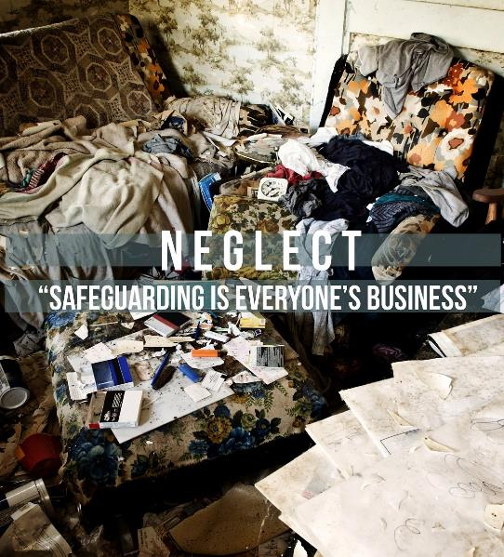
Continued
When considering the steps to take it’s important to recognise that adults sometimes have complex needs and may be ambivalent, unclear or unrealistic about their personal circumstances.
It is about people and organisations working together to prevent, and stop, both the risks and experience of abuse or neglect, while at the same time making sure that the adult’s wellbeing is promoted including, where appropriate, having regard to their views, wishes, feelings and beliefs in deciding on any action.
Understanding the process can help make the decision, whether it’s for the LA or GP and ongoing mental health support, potentially via CMHT.
Importance of clear referral to services, is the hoarding/ self-neglect behaviour, so serious that you believe there is a risk to life, is the person unable to keep themselves safe.

Slide 18
Purpose and objectives of s42 enquiry
A Section 42 Enquiry requires agencies to cooperate with the enquiry by law and share information as required.
When the local authority receives a safeguarding concern, it will initially check if any action is needed to ensure that the adult is safe, and to address immediate risks.
The priority should always be to ensure the safety and well-being of the adult. However, this should be carefully balanced with the adult’s views and wishes and any risks to others. The adult should experience the safeguarding process as empowering and supportive.
The specific objectives of an enquiry are to, where possible:
* Establish facts.
* Ascertain the adult’s views, wishes and desired outcomes.
* Protect the adult from abuse or neglect, in accordance with their wishes
* Assess the needs of the adult for protection and support and how these might be met
* Make decisions as to what action should be taken with regard to the person or organisation thought to be the cause of risk.
* Enable the adult to achieve resolution and recovery

Slide 19
Things to support your decision
Keep the person at the centre of the process and any decisions being made
What are the wishes and expectations of the adult and what outcome are they seeking.
What are the expectations of the organisation
Sign posting and referral options
Be professionally curious
Other multi agency interventions
What’s already in place
Importance of early intervention even if it hasn’t ‘got that bad’ yet

Slide 20
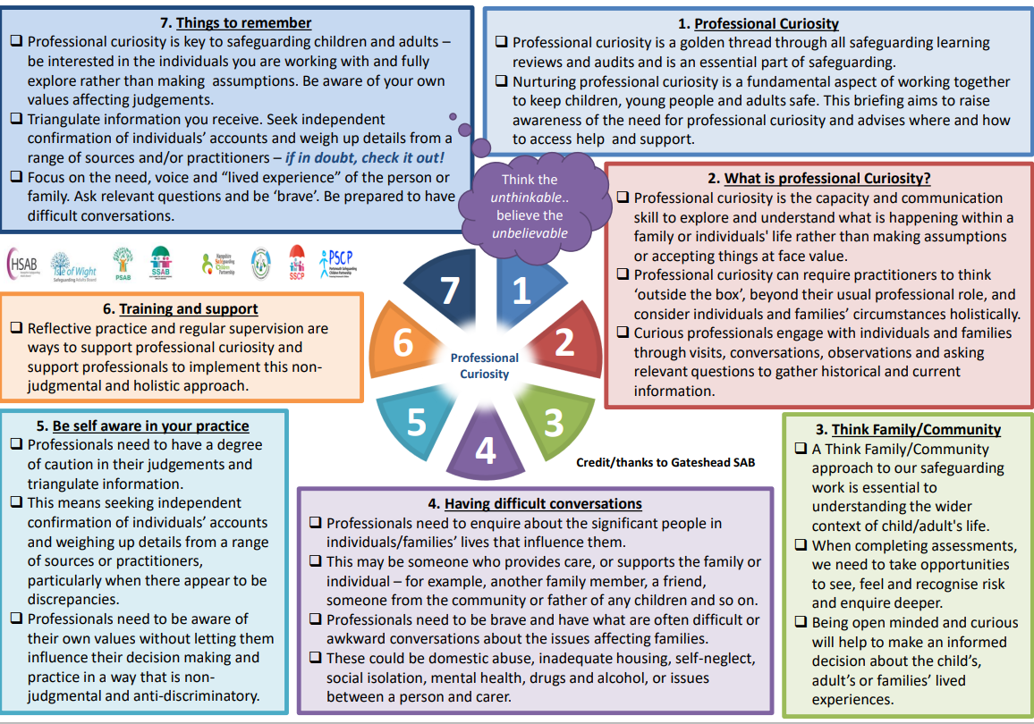
4LSAB 7min Guide to Professional Curiosity (hampshiresab.org.uk)

Slide 21

Multi Agency Response
It is recognised that hoarding and self-neglet are complex conditions and that a variety of agencies may come into contact with the same person.
Often the response can be to advise the relevant agencies involved to co-ordinate the Multi-agency risk management framework (MARM). This guidance is designed to support cases relating to adults where there is a high level of risk but the circumstances may sit outside of the statutory adult safeguarding framework (S42) but for which a multi-agency approach would be beneficial.

Slide 22
What is a MARM meeting and when would you call one
MARM - Multi Agency Risk Management, a meeting of professionals to address presenting risks to an adult in a joined up and holistic way.
MARM is a proactive, person centred approach to focusing on prevention and early intervention to manage risk.
MARM can be initiated by any agency or professional.
MARM is likely to be useful to any professional who is working with Adults who are experiencing a high level of risk from events and circumstances that result in risk of harm to them.
MARM recognises that in complex cases, professionals are often dealing with long term and entrenched behaviours to which responses require a commitment to a longer term, solution-based approach which has at its core, a focus on building trust and a rapport with the adult.
MARM relies on engagement and cooperation between services, appropriate challenge and escalation is an essential part of partnership working and professional responsibilities to achieve high standards. When this doesn’t happen, there is a 4LSAB Escalation Protocol.

Slide 23

Policy and guidance
4LSAB Multi Agency Safeguarding Adults Policy and Guidance 4LSAB Adult Safeguarding Policy Process and Guidance July 2023 (hampshiresab.org.uk)
4LSAB Safeguarding Concerns Guidance 4LSAB Safeguarding Concerns (hampshiresab.org.uk)
4LSAB Multi Agency Risk Management Framework (MARM) 4LSAB MARM (Multi-Agency Risk Management) Framework June 2020 (hampshiresab.org.uk)
4LSAB Multi Agency Safeguarding Adults Escalation Protocol 4LSAB Multi-Agency Safeguarding Adults Escalation Protocol June 2023 (hampshiresab.org.uk)
4LSAB Hoarding Guidance 4LSAB Multi-agency Hoarding Guidance 2022 (hampshiresab.org.uk)
For all other Policies and Guidance please head to our website: Hampshire Safeguarding Adults Board | Working together to safeguard adults at risk (hampshiresab.org.uk)

Slide 24
Any questions?
Thank you

