Slide 1
4LSAB Safeguarding Concerns Guidance October 2020

Slide 2
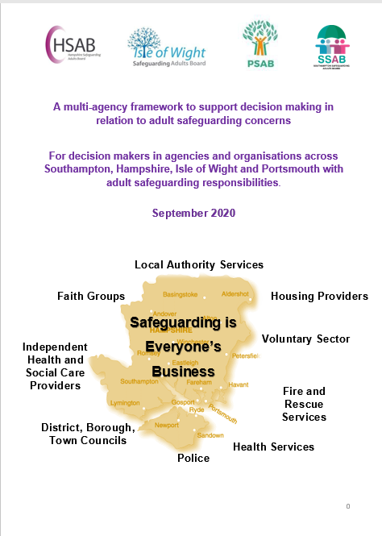
4LSAB Safeguarding Concerns Guidance
What is it?
A multi agency framework to support professionals to make decisions about when to report safeguarding concerns
Notes:
It

Slide 3
4LSAB Safeguarding Concerns Guidance
Why was it developed?
In response to feedback from professionals - we often hear that people are unsure when to refer to safeguarding and would welcome more support and guidance
In response to new national guidance soon to be released from the Local Government Association/Association of Directors of Adult Social Services
To ensure that concerns are addressed in the most appropriate way
To ensure a more consistent approach to what is referred to safeguarding
Notes:
It

Slide 4
4LSAB Safeguarding Concerns Guidance
The guidance promotes:
Personalised approaches which balance well-being with safety and prevention
Engagement with the adult about how best to respond to their safeguarding situations in a way that enhances their involvement, choice, and control
An adult’s rights, ensuring that those who lack mental capacity (as well as those who have capacity) are empowered and included within safeguarding support
Empowering people so that they are partners in understanding and managing risk in their own lives
An emphasis on the need for transparency and openness in managing conflicting outcomes (both of the adult and between the adult and professional organisations)
The role of advocacy in all of the above.
Notes:
It

Slide 5
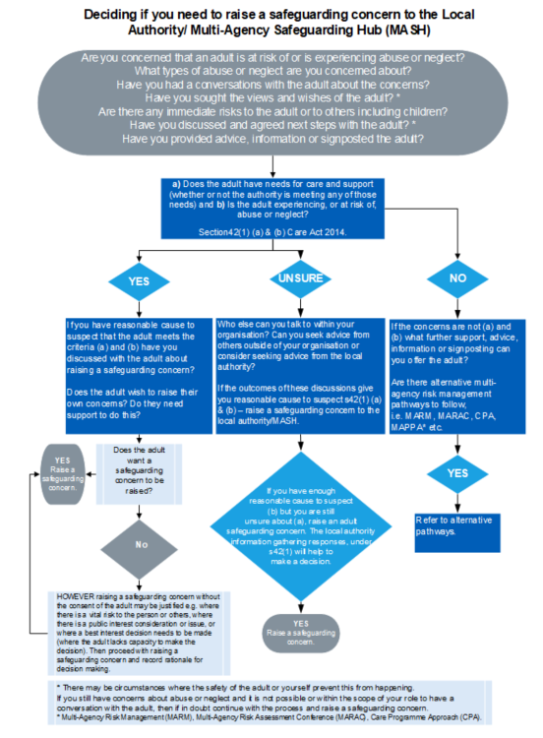
4LSAB Safeguarding Concerns Guidance
What does it include?
Framework – flow charts, core messages
Tools to support decision making
Case studies
Protocol for Falls
Protocol for Pressure Ulcers
Supporting One Minute Guides (including How to make a Referral)
Notes:
It

Slide 6
Tools to support decision making
A series of tables giving pointers on WHEN TO REPORT AS A SAFEGUARDING CONCERN and when the issue is PROBABLY NOT A SAFEGUARDING CONCERN.
These do not replace your professional judgement – if in any doubt phone the Adult MASH team to discuss the case with them first
If you only have time to look at one bit of the concerns guidance, look at the tools! Why not print and laminate them for your team as a reference guide?

Slide 7
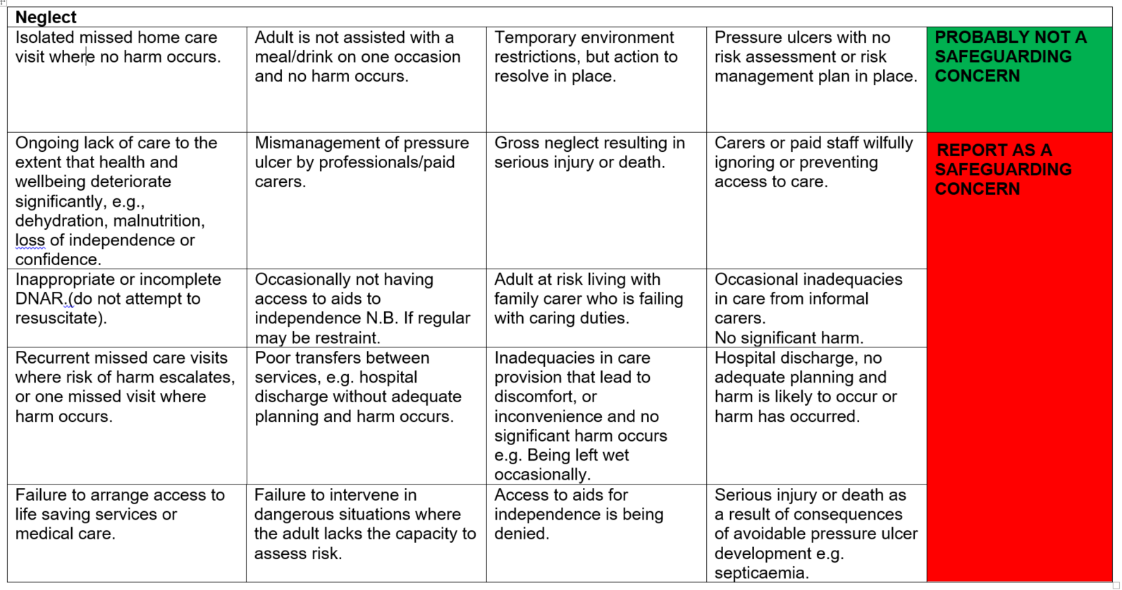
Example page from tools

Slide 8
Further information
Safeguarding Concerns Guidance https://www.portsmouthsab.uk/procedures/
One Minute Guides for Practitioners https://www.portsmouthsab.uk/information-resources-2/
Animated video explaining the safeguarding process https://youtu.be/ToOu2wlkHsw
Questions? Contact the PSAB PSAB@portsmouthcc.fgov.uk or Portsmouth Adult MASH PortsmouthAdultMASH@portsmouthcc.gov.uk

